Slide 1
Introduction to Data Warehouse
Unit 1

Slide 2
Introduction :
A data warehouse is a centralized repository for storing and managing large amounts of data from various sources for analysis and reporting.
It is optimized for fast querying and analysis, enabling organizations to make informed decisions by providing a single source of truth for data.
Data warehousing typically involves transforming and integrating data from multiple sources into a unified, organized, and consistent format.
Data Warehousing Data warehouse can be controlled when the user has a shared way of explaining the trends that are introduced as specific subject.

Slide 3
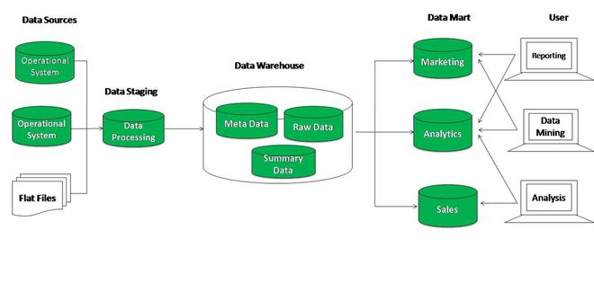
A data warehouse is nothing but an electronic storage that stores large amounts of business information.
It is designed for both query and analysis rather than processing transactions.
Data warehousing is a unique technique that helps collect and manage data from various sources.
Furthermore, these data provide meaningful and valuable business insights.

Slide 4
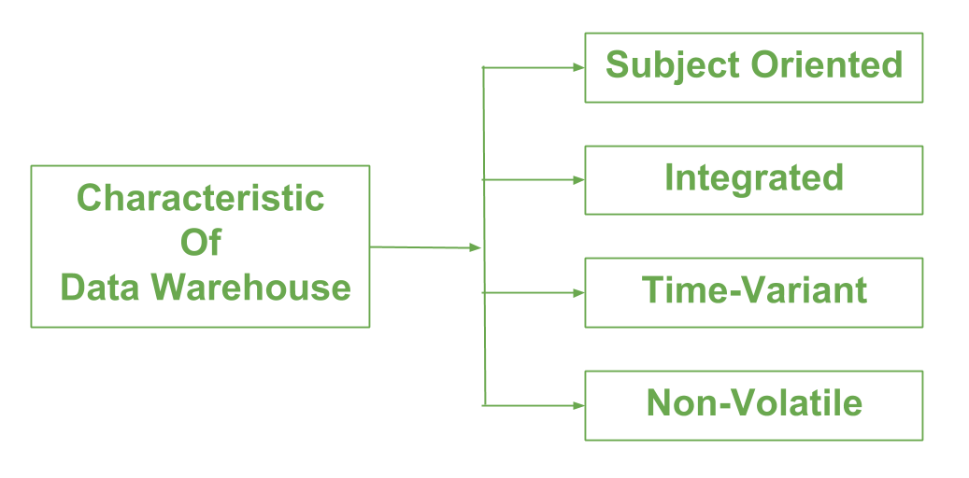
Below are major characteristics of data warehouse :
Subject-oriented – A data warehouse is always a subject oriented as it delivers information about a theme instead of organization’s current operations.
It can be achieved on specific theme.
That means the data warehousing process is proposed to handle with a specific theme which is more defined. These themes can be sales, distributions, marketing etc.
A data warehouse never put emphasis only current operations.
Instead, it focuses on demonstrating and analysis of data to make various decision.
It also delivers an easy and precise demonstration around particular theme by eliminating data which is not required to make the decisions.

Slide 5
Integrated – It is somewhere same as subject orientation which is made in a reliable format.
Integration means founding a shared entity to scale the all-similar data from the different databases.
The data also required to be resided into various data warehouse in shared and generally granted manner.
A data warehouse is built by integrating data from various sources of data such that a mainframe and a relational database.
In addition, it must have reliable naming conventions, format and codes.
Integration of data warehouse benefits in effective analysis of data. Reliability in naming conventions, column scaling, encoding structure etc. should be confirmed.
Integration of data warehouse handles various subject related warehouse.

Slide 6
Time-Variant – In this data is maintained via different intervals of time such as weekly, monthly, or annually etc.
It founds various time limit which are structured between the large datasets and are held in online transaction process (OLTP).
The time limits for data warehouse is wide-ranged than that of operational systems.
The data resided in data warehouse is predictable with a specific interval of time and delivers information from the historical perspective.

Slide 7
Non-Volatile – As the name defines the data resided in data warehouse is permanent.
It also means that data is not erased or deleted when new data is inserted.
It includes the mammoth quantity of data that is inserted into modification between the selected quantity on logical business.
It evaluates the analysis within the technologies of warehouse.
Data is not updated, once it is stored in the data warehouse, to maintain the historical data.
In this, data is read-only and refreshed at particular intervals.

Slide 8
Functions of Data warehouse:
It has stocked facts about the tables which have high transaction levels which are observed so as to define the data warehousing techniques and major functions which are involved in this are mentioned below:
Data Consolidation: The process of combining multiple data sources into a single data repository in a data warehouse. This ensures a consistent and accurate view of the data.
Data Cleaning: The process of identifying and removing errors, inconsistencies, and irrelevant data from the data sources before they are integrated into the data warehouse. This helps ensure the data is accurate and trustworthy.
Data Integration: The process of combining data from multiple sources into a single, unified data repository in a data warehouse. This involves transforming the data into a consistent format and resolving any conflicts or discrepancies between the data sources.

Slide 9
Data Storage: A data warehouse can store large amounts of historical data and make it easily accessible for analysis.
Data Transformation: Data can be transformed and cleaned to remove inconsistencies, duplicate data, or irrelevant information.
Data Analysis: Data can be analyzed and visualized in various ways to gain insights and make informed decisions.
Data Reporting: A data warehouse can provide various reports and dashboards for different departments and stakeholders.
Data Mining: Data can be mined for patterns and trends to support decision-making and strategic planning.
Performance Optimization: Data warehouse systems are optimized for fast querying and analysis, providing quick access to data.

Slide 10
Applications of Data Warehouses:
The applications of data warehouses include:
Banking Services
Consumer Goods
Manufacturing
Financial Services
Retail Sectors

Slide 11
The essential components are discussed below:
External Sources – External source is a source from where data is collected irrespective of the type of data.
Data can be structured, semi structured and unstructured as well.
Stage Area – Since the data, extracted from the external sources does not follow a particular format, so there is a need to validate this data to load into data warehouse.
For this purpose, it is recommended to use ETL tool.
E(Extracted): Data is extracted from External data source.
T(Transform): Data is transformed into the standard format.
L(Load): Data is loaded into data warehouse after transforming it into the standard format.

Slide 12
Data-warehouse –
After cleansing of data, it is stored in the data warehouse as central repository.
It actually stores the meta data and the actual data gets stored in the data marts.
Note that data warehouse stores the data in its purest form in this top-down approach.

Slide 13
Data Marts –
Data mart is also a part of storage component.
It stores the information of a particular function of an organization which is handled by single authority.
There can be as many number of data marts in an organization depending upon the functions.
We can also say that data mart contains subset of the data stored in Datawarehouse.

Slide 14
Data Mining –
The practice of analyzing the big data present in Datawarehouse is data mining.
It is used to find the hidden patterns that are present in the database or in Datawarehouse with the help of algorithm of data mining.
This approach is defined by Inmon as – Datawarehouse as a central repository for the complete organization and data marts are created from it after the complete Datawarehouse has been created.

Slide 15
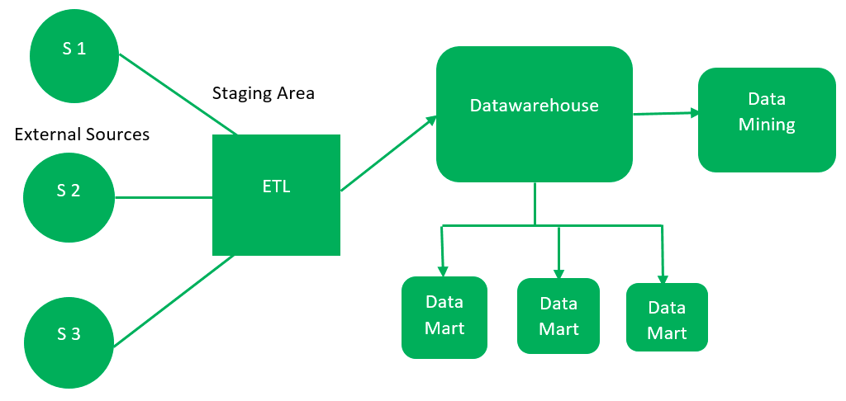
Data Warehouse Architecture
A data-warehouse is a heterogeneous collection of different data sources organized under a unified schema.
There are 2 approaches for constructing data-warehouse:
Top-down approach and
Bottom-up approach.
1. Top-down approach:

Slide 16
Advantages of Top-Down Approach –
Since the data marts are created from the Datawarehouse, provides consistent dimensional view of data marts.
Also, this model is considered as the strongest model for business changes. That’s why, big organizations prefer to follow this approach.
Creating data mart from Datawarehouse is easy.

Slide 17
Disadvantages of Top-Down Approach –
The cost, time taken in designing and its maintenance is very high.
Complexity: The top-down approach can be complex to implement and maintain, particularly for large organizations with complex data needs. The design and implementation of the data warehouse and data marts can be time-consuming and costly.
Lack of flexibility: The top-down approach may not be suitable for organizations that require a high degree of flexibility in their data reporting and analysis. Since the design of the data warehouse and data marts is pre-determined, it may not be possible to adapt to new or changing business requirements.

Slide 18
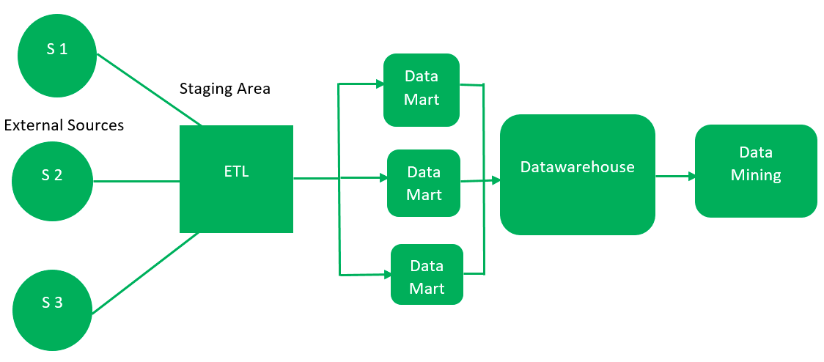
First, the data is extracted from external sources (same as happens in top-down approach).
Then, the data go through the staging area (as explained above) and loaded into data marts instead of Datawarehouse.
The data marts are created first and provide reporting capability.
It addresses a single business area.
These data marts are then integrated into Datawarehouse.
2. Bottom-up approach:

Slide 19
This approach is given by Kinball as – data marts are created first and provides a thin view for analyses and Datawarehouse is created after complete data marts have been created.
Advantages of Bottom-Up Approach –
As the data marts are created first, so the reports are quickly generated.
We can accommodate more number of data marts here and in this way datawarehouse can be extended.
Also, the cost and time taken in designing this model is low comparatively.

Slide 20
Disadvantage of Bottom-Up Approach –
This model is not strong as top-down approach as dimensional view of data marts is not consistent as it is in above approach.
Integration challenges: Because the bottom-up approach relies on the integration of multiple data marts, it can be more difficult to integrate data from different sources and ensure consistency across the organization.
This can lead to issues with data quality and accuracy.

Slide 21
Multi-tier architecture of Data Warehouse
A data warehouse is Representable by data integration from multiple heterogeneous sources.
It is a system used for data analysis and reporting.
Data Warehouse is referred to the data repository that is maintained separately from the organization’s operational data.
Multi-Tier Data Warehouse Architecture consists of the following components:
Bottom Tier
Middle Tier
Top Tier

Slide 22
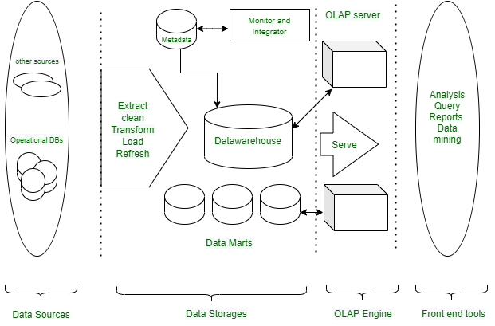

Slide 23
Bottom Tier(Data sources and data storage) :
The bottom Tier usually consists of Data Sources and Data Storage.
It is a warehouse database server. For Example RDBMS.
In Bottom Tier, using the application program interface(called gateways), data is extracted from operational and external sources.
Application Program Interface likes ODBC(Open Database Connection), OLE-DB(Open-Linking and Embedding for Database), JDBC(Java Database Connection) is supported.
ETL stands for Extract, Transform, and Load. Several popular ETL tools include: I. IBM Infosphere II. Informatica III. Confluent IV. Microsoft SSIS V. Snaplogic VI. Alooma

Slide 24
Middle Tier :
The middle tier is an OLAP server that is typically implemented using either :
A relational OLAP (ROLAP) model (i.e., an extended relational DBMS that maps operations from standard data to standard data);
or A multidimensional OLAP (MOLAP) model (ie, a special purpose server that directly implements multidimensional data and operations).

Slide 25
Top Tier :
The top tier is a front-end client layer, which includes query and reporting tools, analysis tools, and/or data mining tools (e g, trend analysis, prediction, etc.).
Here are a few Top Tier tools that are often used: I. SAP BW II. SAS Business Intelligence III. IBM Cognos IV. Crystal Reports V. Microsoft BI Platform

Slide 26
Advantages of Multi-Tier Architecture of Data warehouse
Scalability: Various components can be added, deleted, or updated in accordance with the data warehouse’s shifting needs and specifications.
Better Performance: The several layers enable parallel and efficient processing, which enhances performance and reaction times.
Security: The data warehouse’s overall security can be improved by applying various security measures to various layers.
Disadvantages
1.Cost: Can be expensive to implement and maintain, particularly for smaller organizations that may not have the resources to invest in a large-scale data warehouse and associated data marts

Slide 27
Data warehousing is essential for centralizing massive volumes of data from disparate sources into a single, structured repository for enhanced analysis and reporting.
It supports business intelligence (BI) by providing a consistent, "single source of truth" for historical analysis, trend forecasting, and data-driven decision-making, which traditional operational databases cannot handle efficiently.
Needs for Data Warehousing:
Centralized Data Repository:
Combines disparate data from multiple sources (e.g., CRMs, ERPs, flat files) into a unified view.
Historical Data Analysis:
Stores long-term data, enabling companies to analyze trends over time and predict future performance.
Enhanced Decision Making:
Provides high-quality, cleansed, and consistent data for improved BI reporting and strategic decisions.

Slide 28
Improved Query Performance:
Optimized for fast, complex analytical queries without slowing down day-to-day operational databases.
Scalability & Cost Efficiency:
Modern cloud data warehouses offer on-demand scaling (e.g., Snowflake, Google BigQuery) and pay-as-you-go pricing to manage large datasets economically.
Data Security & Compliance:
Enables role-based access control (RBAC) and simplifies regulatory compliance (like GDPR or HIPAA) by consolidating data in a secure environment.
Business Intelligence Support:
Feeds data directly into AI, machine learning, and visualization tools (like Tableau or Power BI) for advanced insights.

Slide 29
Data warehousing trends in 2026 are heavily focused on cloud-native scalability, real-time analytics, and AI-driven automation.
Key shifts include the rise of data lake houses, which merge structured and unstructured data, and the adoption of zero-copy data sharing for secure, instant access without duplication.
Trends in Data Warehousing
Cloud-Native & Hybrid Architectures:
Migration to cloud platforms like Snowflake, Google BigQuery, and Amazon Redshift is accelerating, driven by demand for elastic scalability and cost-efficiency.
Data Lakehouse Adoption:
Converging data warehouses and data lakes, allowing organizations to manage both structured and unstructured data in one place, reducing data silo issues.

Slide 30
Real-Time Data Processing:
Integration with streaming technologies (e.g., Apache Kafka) now allows near-instant ingestion and analysis, moving away from nightly batch processing.
AI & Automation Integration:
AI and Machine Learning (ML) are being used for automated data management, including data cleansing, query optimization, and anomaly detection.
Zero-Copy Data Sharing:
Technologies such as Snowflake's zero-copy cloning or Databricks' Delta Sharing allow sharing data between organizations without moving or copying the data, enhancing security and reducing storage costs.
Serverless Data Warehousing:
Companies are moving toward serverless models that eliminate infrastructure management, allowing teams to focus on data utilization.
Data Mesh & Data Fabric Concepts:
Shifting from a single centralized warehouse to decentralized architectures where data is treated as a product and managed by specific business domains.

